Slide 1
人生中
面對
巨人

Slide 2
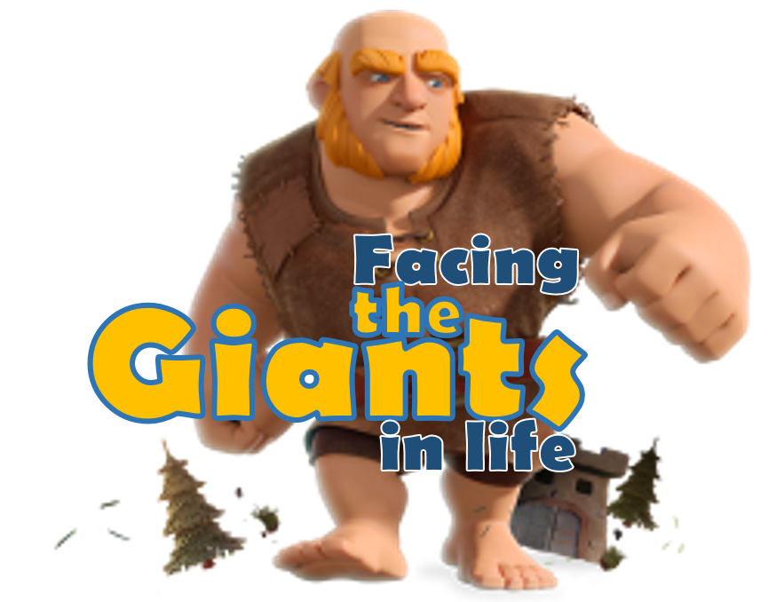
人生中
面對
巨人
Notes:
Would you believe it? Today we are going to talk about games, strategy, on how to win, and Insider’s information.
This is a game I call “Giant GO”
To talk about this game, I need to start with another game… [next slide]

Slide 3
Giant #1 – We need to accept it
巨人一：我们须要接受
Giant #2 – We need to battle it
巨人二：我们须要对付
Giant #3 – We need to respect it
巨人三：我们须要尊重
Giant #4 – We need to be aware of it
巨人四：我们须要意识
Giant #5 – We need to trust in HIM
巨人五：我們须要倚靠
Notes:
No, He does not smash through all the giants in your life.
Some of these giants you need to accept,
some you need to conquer
Some you need to respect
Some you need to be aware
And there is one ULTIMATE Giant, the only one true God, and we need to trust Him.
Go through and identifies your giants
Giant #1 – Your brothers and sisters, your parents,
Giant #2 – who is your goliath. – not fresh and bone, but ideas – anti God ideas. Teaching that belittles God. Moral standard that defies God.
Giant #3 – your brothers and sisters in the church. Christ died for all of us. We need to respect. Doesn’t mean we need to agree with everything. But even in our disagreement, we need to respectfully disagree.
That means no gossip about other people, no spreading rumors, no laughing at other people. Respect.
Giant #4 – We need to be aware of our own issues, the issues of our sinful heart.

Slide 4
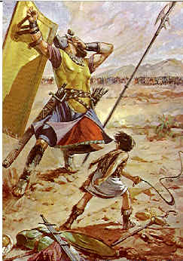
Giant #2:
Goliath
歌利亞

Slide 5
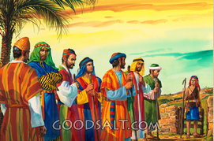
Giant #1:
His Brothers
Notes:
If you know the story. It is a story when God instructed Samuel to come to find David.
Samuel doesn’t know that he comes to find David yet, Only God knows.
But Samuel comes to Jesse the father and asks him to gather all of his sons for dinner.
But Jesse only gathers the first 7 sons, and forgetting David in the field tending the sheep.
It is the case where David is ignored by even his own father.
The fact is David has big and strong brothers who are more capable than him in many regard, and David is like “extra.”
From David’s life story, we have reasons to believe that his older brothers look down on David a lot.
Now here is the Giant #1 – His own brothers. It is different than the big giant Goliath. But it is a giant nonetheless.
How does David face these giants?

Slide 6
詩篇
Psalm 8

Slide 7
詩篇Psalm 3
詩篇Psalm 4
詩篇Psalm 5
詩篇Psalm 6
詩篇Psalm 7
詩篇Psalm 9
詩篇Psalm 10
詩篇Psalm 11
詩篇Psalm 12
詩篇Psalm 13
詩篇
Psalm 8

Slide 8
Foes are Many
詩篇Psalm 4
詩篇Psalm 5
詩篇Psalm 6
詩篇Psalm 7
詩篇Psalm 9
詩篇Psalm 10
詩篇Psalm 11
詩篇Psalm 12
詩篇Psalm 13
詩篇
Psalm 8

Slide 9
Foes are Many
Shame & Sleepless
詩篇Psalm 5
詩篇Psalm 6
詩篇Psalm 7
詩篇Psalm 9
詩篇Psalm 10
詩篇Psalm 11
詩篇Psalm 12
詩篇Psalm 13
詩篇
Psalm 8

Slide 10
Foes are many
Shame & sleepless
Arrogant & liars
詩篇Psalm 6
詩篇Psalm 7
詩篇Psalm 9
詩篇Psalm 10
詩篇Psalm 11
詩篇Psalm 12
詩篇Psalm 13
詩篇
Psalm 8

Slide 11
Foes are many
Shame & sleepless
Arrogant & liars
Deep anguish
詩篇Psalm 7
詩篇Psalm 9
詩篇Psalm 10
詩篇Psalm 11
詩篇Psalm 12
詩篇Psalm 13
詩篇
Psalm 8

Slide 12
Foes are many
Shame & sleepless
Arrogant & liars
Deep anguish
Tear like a lion
詩篇Psalm 9
詩篇Psalm 10
詩篇Psalm 11
詩篇Psalm 12
詩篇Psalm 13
詩篇
Psalm 8

Slide 13
Foes are many
Shame & sleepless
Arrogant & liars
Deep anguish
Tear like a lion
Slanders
詩篇Psalm 10
詩篇Psalm 11
詩篇Psalm 12
詩篇Psalm 13
詩篇
Psalm 8

Slide 14
Foes are many
Shame & sleepless
Arrogant & liars
Deep anguish
Tear like a lion
Slanders
Oppressors
詩篇Psalm 11
詩篇Psalm 12
詩篇Psalm 13
詩篇
Psalm 8

Slide 15
Foes are many
Shame & sleepless
Arrogant & liars
Deep anguish
Tear like a lion
Slanders
Oppressors
Foundation destroyed
詩篇Psalm 12
詩篇Psalm 13
詩篇
Psalm 8

Slide 16
Foes are many
Shame & sleepless
Arrogant & liars
Deep anguish
Tear like a lion
Slanders
Oppressors
Foundation destroyed
No one is good
詩篇Psalm 13
詩篇
Psalm 8

Slide 17
Foes are many
Shame & sleepless
Arrogant & liars
Deep anguish
Tear like a lion
Slanders
Oppressors
Foundation destroyed
No one is good
They are winning
詩篇
Psalm 8

Slide 18
1Sa 16:11 Then Samuel said to Jesse, "Are all your sons here?" And he said, "There remains yet the youngest, but behold, he is keeping the sheep." And Samuel said to Jesse, "Send and get him, for we will not sit down till he comes here." 撒母耳對耶西說：「你的兒子都在這裡嗎？」他回答說：「還有個小的，現在放羊。」撒母耳對耶西說：「你打發人去叫他來；他若不來，我們必不坐席。」

Slide 19
1Sa 17:28 …And Eliab's anger was kindled against David, and he said, "Why have you come down? And with whom have you left those few sheep in the wilderness? I know your presumption and the evil of your heart, for you have come down to see the battle." 大衛的長兄以利押聽見大衛與他們所說的話，就向他發怒，說：「你下來做什麼呢？在曠野的那幾隻羊，你交託了誰呢？我知道你的驕傲和你心裡的惡意，你下來特為要看爭戰！」

Slide 20
1Sa 17:28 …And Eliab's anger was kindled against David, and he said, "Why have you come down? And with whom have you left those few sheep in the wilderness? I know your presumption and the evil of your heart, for you have come down to see the battle." 大衛的長兄以利押聽見大衛與他們所說的話，就向他發怒，說：「你下來做什麼呢？在曠野的那幾隻羊，你交託了誰呢？我知道你的驕傲和你心裡的惡意，你下來特為要看爭戰！」

Slide 21
Psalm 8
1 O LORD, our Lord, how majestic is your name in all the earth! You have set your glory above the heavens. 2 Out of the mouth of babies and infants, you have established strength because of your foes, to still the enemy and the avenger. 3 When I look at your heavens, the work of your fingers, the moon and the stars, which you have set in place, 4 what is man that you are mindful of him, and the son of man that you care for him?

Slide 22
5 Yet you have made him a little lower than the heavenly beings and crowned him with glory and honor. 6 You have given him dominion over the works of your hands; you have put all things under his feet, 7 all sheep and oxen, and also the beasts of the field, 8 the birds of the heavens, and the fish of the sea, whatever passes along the paths of the seas. 9 O LORD, our Lord, how majestic is your name in all the earth!

Slide 23
Psalm 8
1 O LORD, our Lord, how majestic is your name in all the earth! You have set your glory above the heavens. 2 Out of the mouth of babies and infants, you have established strength because of your foes, to still the enemy and the avenger. 3 When I look at your heavens, the work of your fingers, the moon and the stars, which you have set in place, 4 what is man that you are mindful of him, and the son of man that you care for him?

Slide 24
Psalm 8
1 O LORD, our Lord, how majestic is your name in all the earth! You have set your glory above the heavens. 2 Out of the mouth of babies and infants, you have established strength because of your foes, to still the enemy and the avenger. 3 When I look at your heavens, the work of your fingers, the moon and the stars, which you have set in place, 4 what is man that you are mindful of him, and the son of man that you care for him?

Slide 25
Psalm 8
1 O LORD, our Lord, how majestic is your name in all the earth! You have set your glory above the heavens. 2 Out of the mouth of babies and infants, you have established strength because of your foes, to still the enemy and the avenger. 3 When I look at your heavens, the work of your fingers, the moon and the stars, which you have set in place, 4 what is man that you are mindful of him, and the son of man that you care for him?

Slide 26
